Slide 1

On prosody and reported speech
Towards an
exploratory methodology
Leonardo Contreras Roa
LLACAN UMR 8135
December 12, 2020

Slide 2
A bit of theory
Speakers “do not always explicitly introduce different ‘voices’ with reporting verbs or quotative constructions. Instead, figures are often ‘brought on stage’ for the first time merely by being animated, without, for instance, a prefatory he said or she said. […]
The figure’s ‘voice’ must be reconstructibly different from the current speaker’s own ‘voice’”. (Couper-Kuhlen, 1997, p. 13)
→ Prosodic and paralinguistic features

Slide 3
A bit of theory
“Prosodic and paralinguistic effects are in fact deictic to a certain extent: they involve speaking within a given range of relative loudness, pitch and tempo […] and with a given voice quality.” (p. 14)

Slide 4
A bit of theory
Prosodically, reported speech can be more or less integrated into the quotative frame. This helps establishing a distance from the narrator’s own voice.
The degree of prosodic integration depends on several features (Genetti, 2011):
  Positioning of prosodic and syntactic boundaries
  Patterns of terminal contours
  Changes in:
    Loudness
    Pitch range
    Register
    Timing
Separate intonational unit
(IU)

Slide 5
Objectives
Determining if reported speech is prosodically detached from the quotative frame in storytelling in [language].
If it is,
Identifying in which cases.
Describing how (acoustically/phonetically).

Slide 6
Acoustic correlates of perceptive variables
Perceptive Acoustic
Pitch variations → F0 (Hz, st)
Pause duration → Time (s)
Speech rate → Syllables or phonemes/s (including pauses)
Loudness variations → Intensity (dB)

Slide 7
1. Pitch variations
Reported (direct) speech in English and other European languages:
Higher pitch range than indirect speech
  (ΔF0, i.e. F0_{max} - F0_{min})
Pitch reset (with respect to previous IU)
Register change (with respect to previous IU)

Slide 8
2. Pause duration
Reporting events can also be separated from non-reported speech by pauses.
  → o.325s in average after reports
  (vs. 0.244s elsewhere) (Oliveira & Cunha, 2004)

Slide 9
3. Speech rate
Changes in speech rate (number of syllables/second). 🤔
Intensity measurements rely heavily on good audio quality. 😩
4. Intensity variations

Slide 10
Paralinguistic features
Changes in voice quality are also often used to signal reports:
  Creaky voice
  Breathy voice
  Falsetto
  Other types of non-modal phonation

Slide 11
Typological issues
Word order seems to affect the placement of IU breaks.
  (cf. Malibert & Vanhove, 2015)
Tonal languages with downdrift, where pitch reset does not necessarily mark the start of a new IU.

Slide 12
Prosodic “universals”?
Variable prosodic behavior: Prosody signals reported speech as a complement of morphosyntactic cues. In absence of the latter, prosodic cues tend to be present.
Length: Short speech reports tend to be more integrated into the quotative frame.
(Genetti, 2014)

Slide 13
A few examples
in conversational English

Slide 14

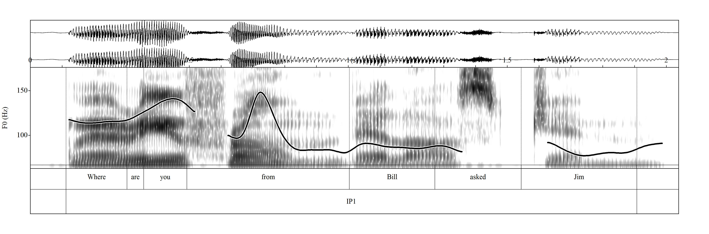
English Intonation: an Introduction (Workbook)
“When reporting clauses […] follow quoted words, they are usually out of focus. The nucleus goes on the appropriate
item among the quoted words, and the reporting clause forms a tail to the IP. […]
There is often a rhythmic break between the quoted words and the reporting clause.” (Wells, 2006)

Slide 15
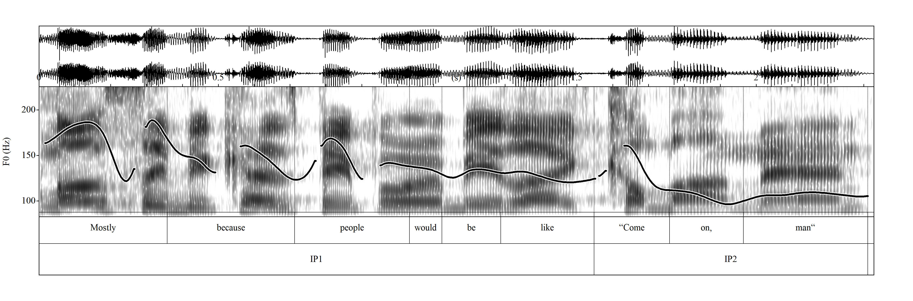
The Graham Norton Show
132 → 173 Hz
∆4.68 st

Slide 16
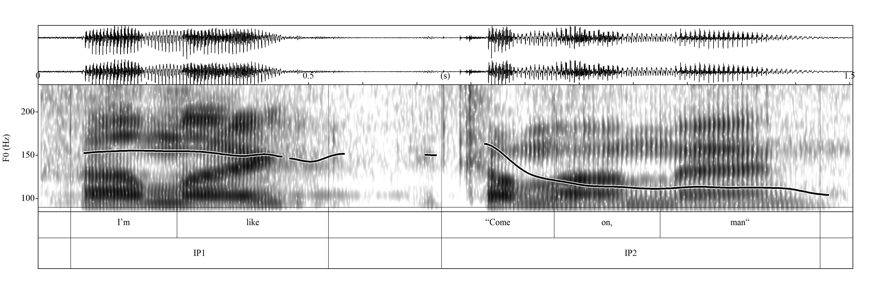
The Graham Norton Show
159 → 170 Hz
∆1.16 st
0,21s

Slide 17
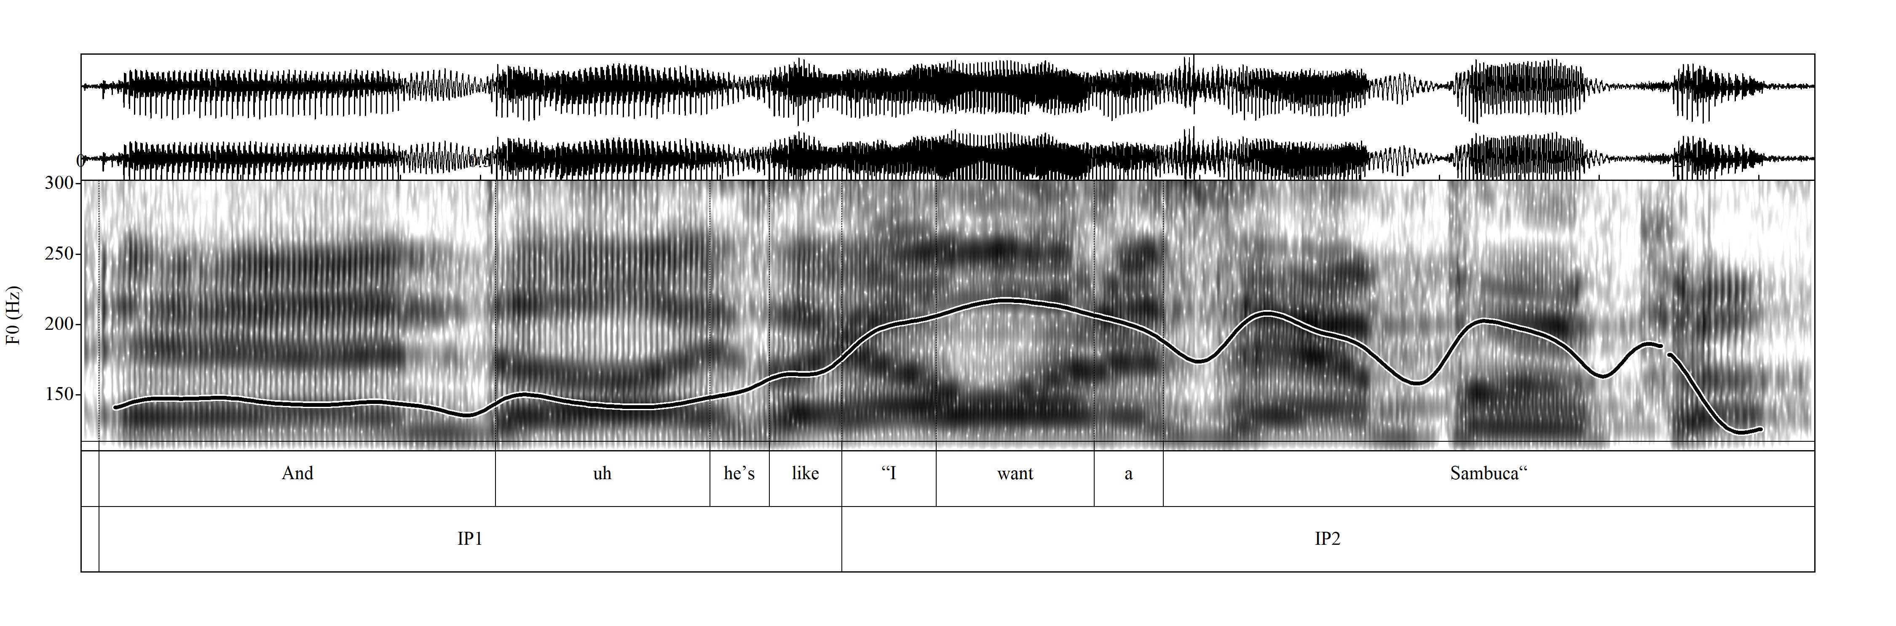
The Graham Norton Show
163 → 197 Hz
∆3.29 st

Slide 18
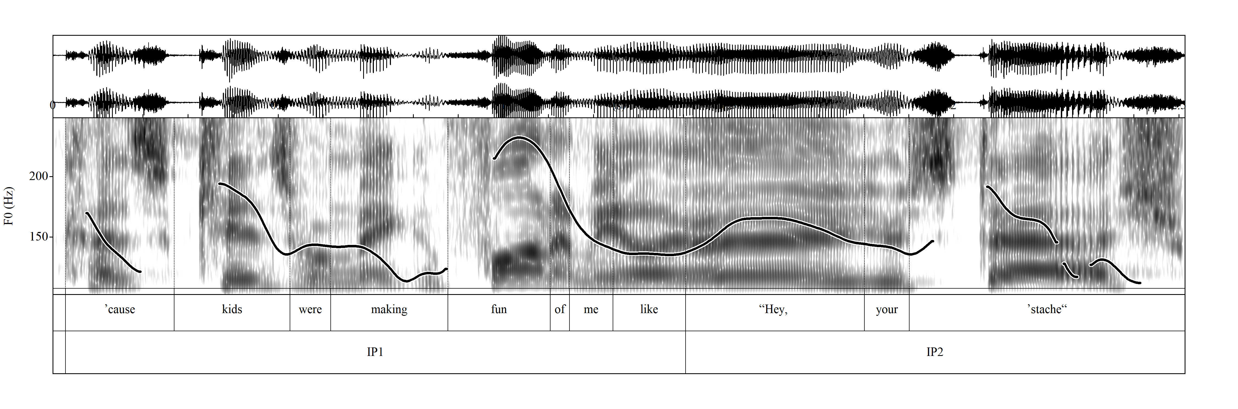
The Graham Norton Show
136 → 167 Hz
∆3.56 st

Slide 19
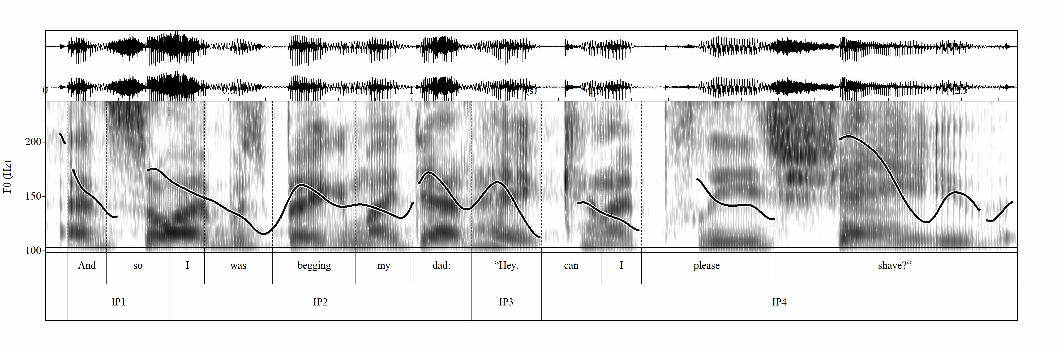
The Graham Norton Show
173 → 168 Hz
∆-0.51 st

Slide 20
Caveat
Performing analyses and IU segmentations requires some knowledge of the prosodic system of a language:
  Is the language stress-timed or syllable-timed?
  What is the default nucleus placement?
  Are specific contours associated to specific meanings?
  In tonal languages: is there tonal downdrift? (pitch resets)
  Etc.

Slide 21
An exploratory methodology
A proposal

Slide 22
A bottom-up approach
Annotating and extracting everything to see if regularities arise.

Slide 23
A bottom-up approach
Final contour
Final contour
Final contour
∆F0
reset
∆F0
reset
∆F0
reset
∆F0
reset
Non-RS
Pre-report
DR Event, QUOT, etc.
Report
Post-report
DR Event, QUOT, etc.
Non-RS
∆F0
∆F0
∆F0
s
s
s
s
speech rate
speech rate
speech rate
Time

Slide 24
A bottom-up approach
Step 1
Based on the collected data, we can make a descriptive analysis to see if any trends appear.

Slide 25
A bottom-up approach
Step 2
We can then establish categorical variables:
Length of RS:
  Short: 1 – 3 syllables
  Medium: 3 – 10 syllables
  Long: 10+ syllables
Length of pauses:
  No pause
  Short: 0,10 – 0,30 s
  Medium: 0,31 – 0,50 s
  Long: 0,51+ s
∆F0 reset:
Absent: -3 semitones
Present: +3,1 semitones
∆F0:
Small: -3 semitones
Medium: 3,1 – 5 semitones
Large: +5 semitones
Speech rate:
Slow
Medium
Fast
Final contour:
Rising
Low-rising
Falling
High-falling
Level

Slide 26
A bottom-up approach
Step 3
Confronting these new variables with variables we already know and wish to explore:
Presence of pre/post-report/DR Event:
  Yes
  No
Type of elocution:
  Read-aloud
  By heart
  Spontaneous?
Speaker
Tonal language:
  Yes
  No
Language family
Cross-linguistic analysis
→ Establishing a typology?

Slide 27
A few more examples
Chuvash and
u̠t-ma’in

Slide 28
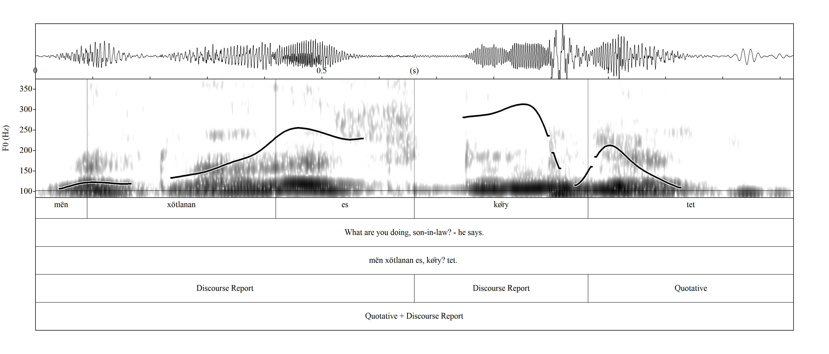
Chuvash

Slide 29
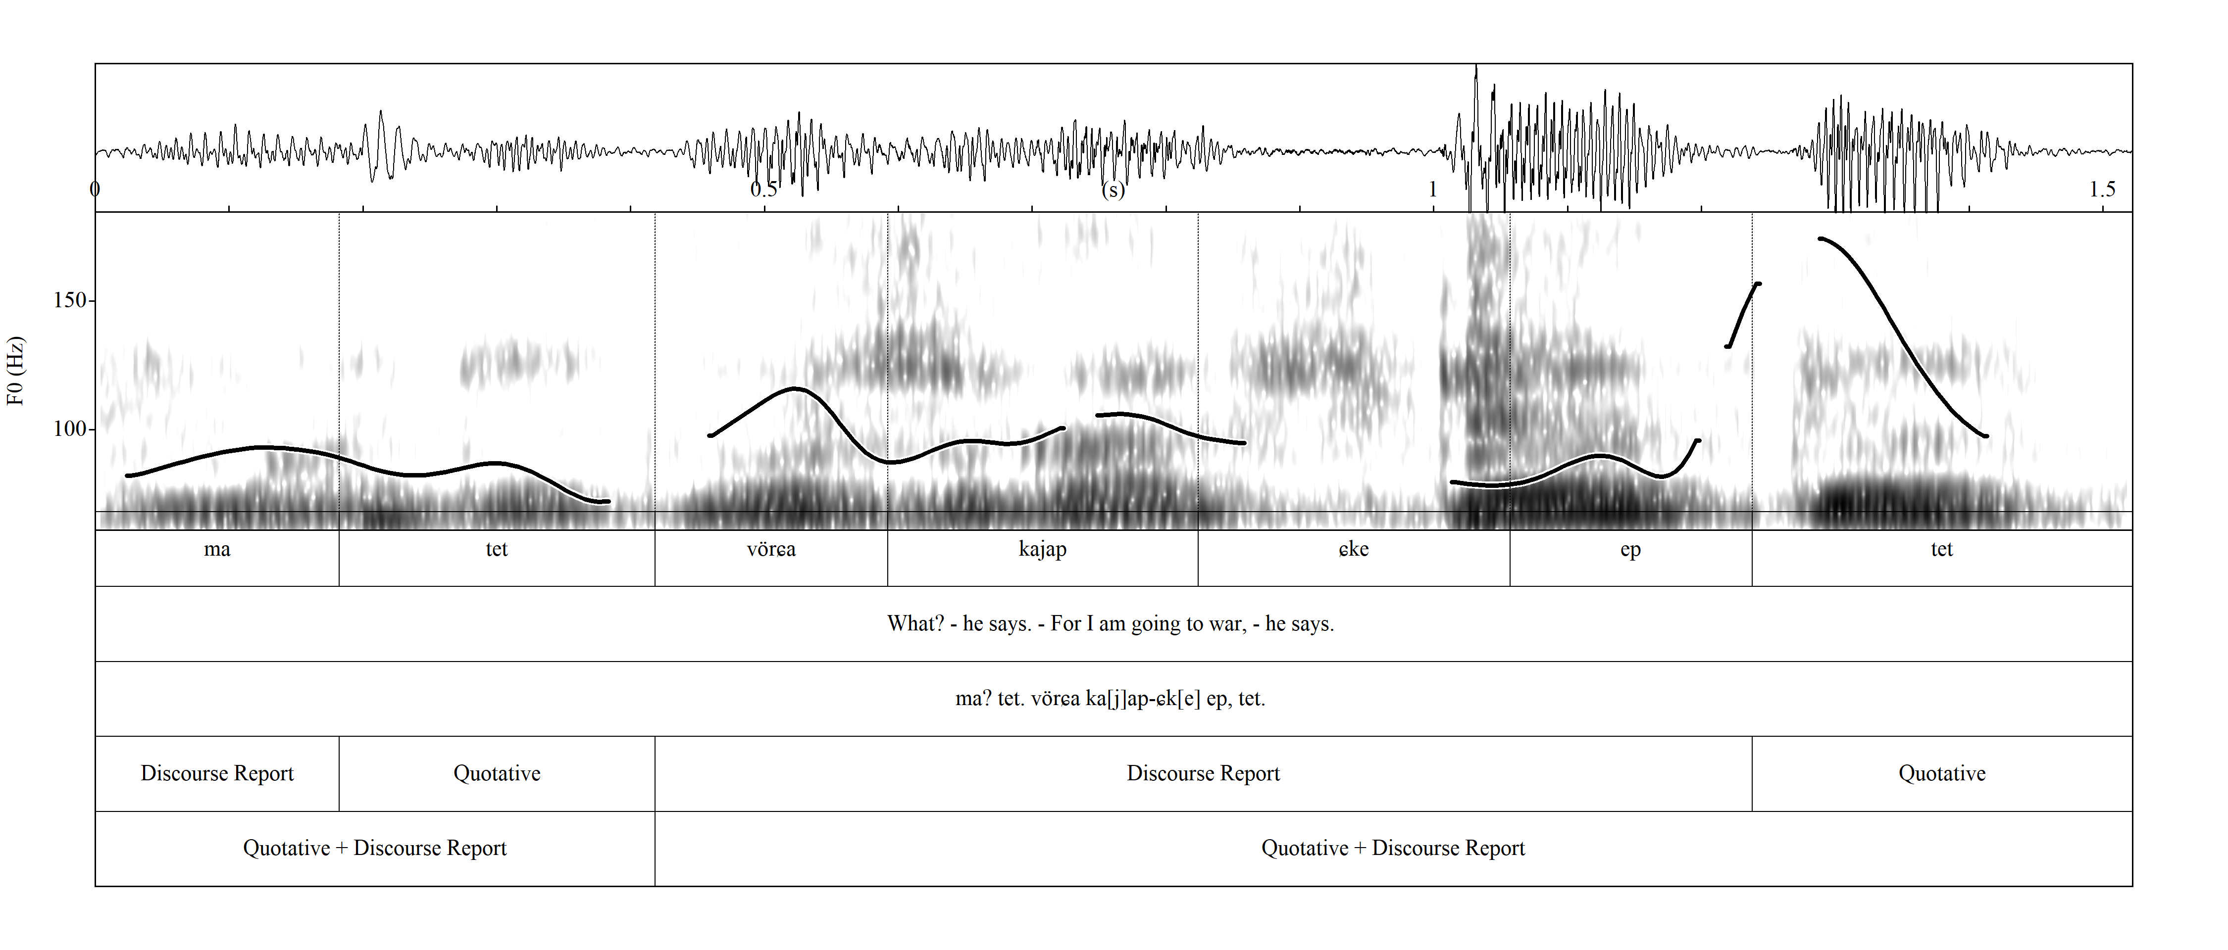
Chuvash

Slide 30
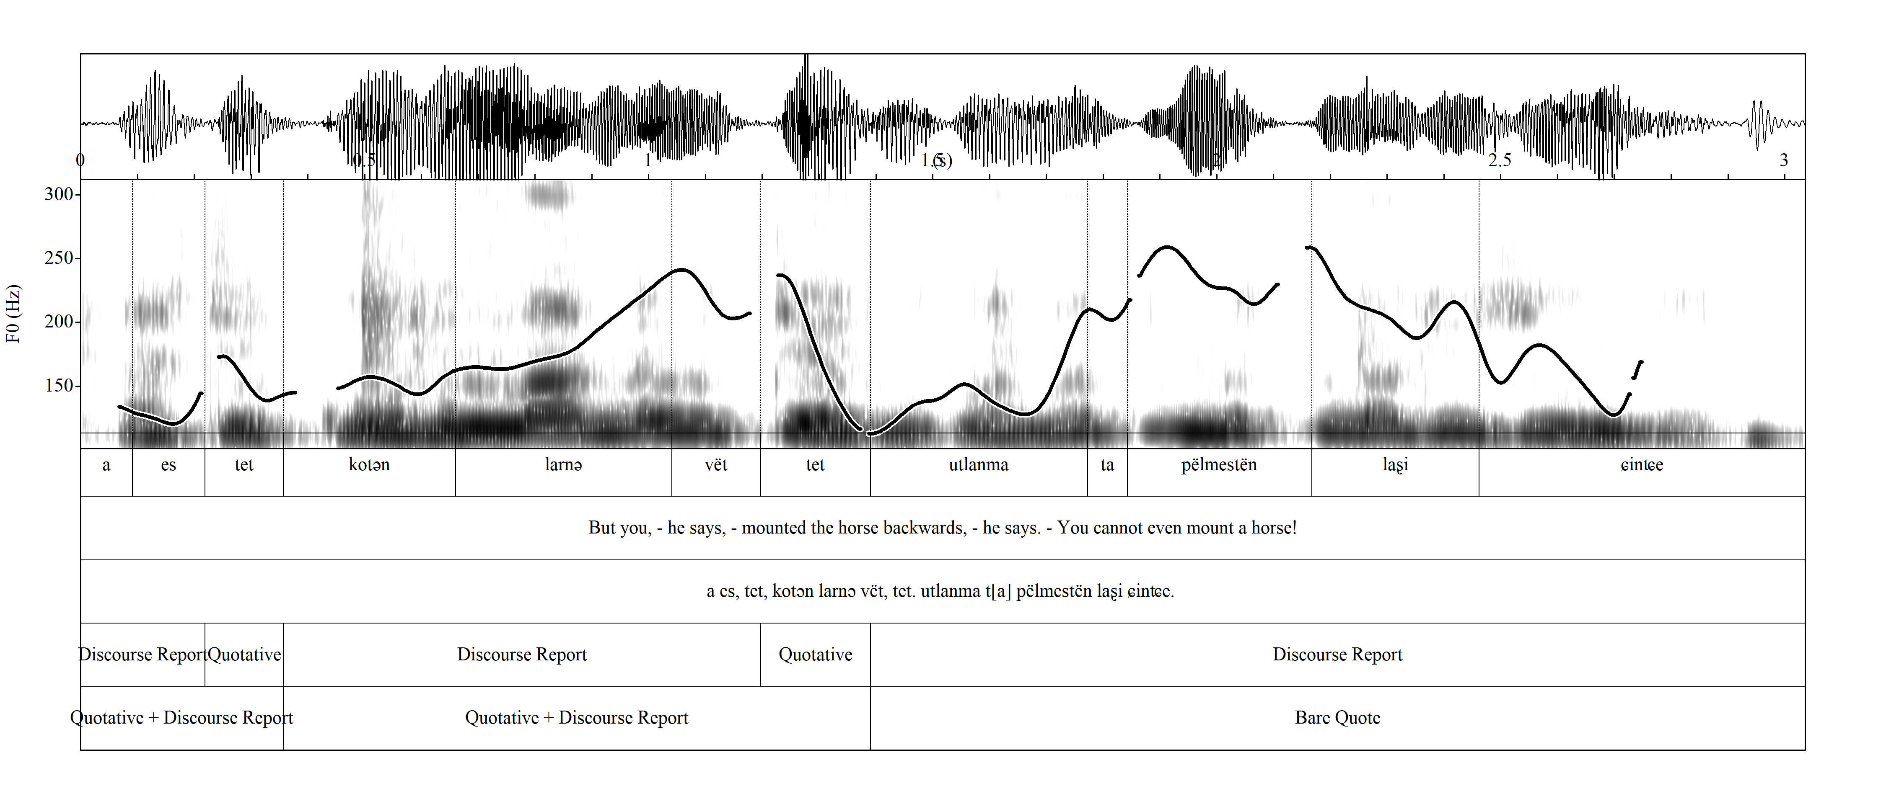
Chuvash

Slide 31
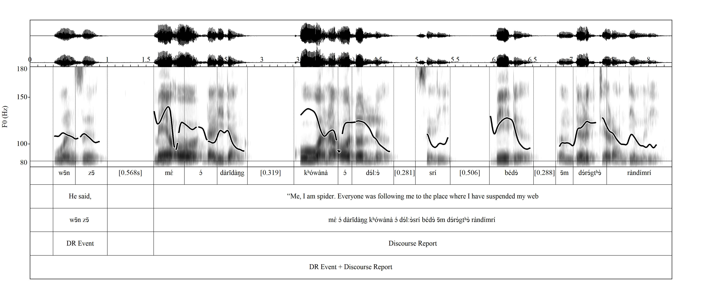
u̠t-Ma'in

Slide 32
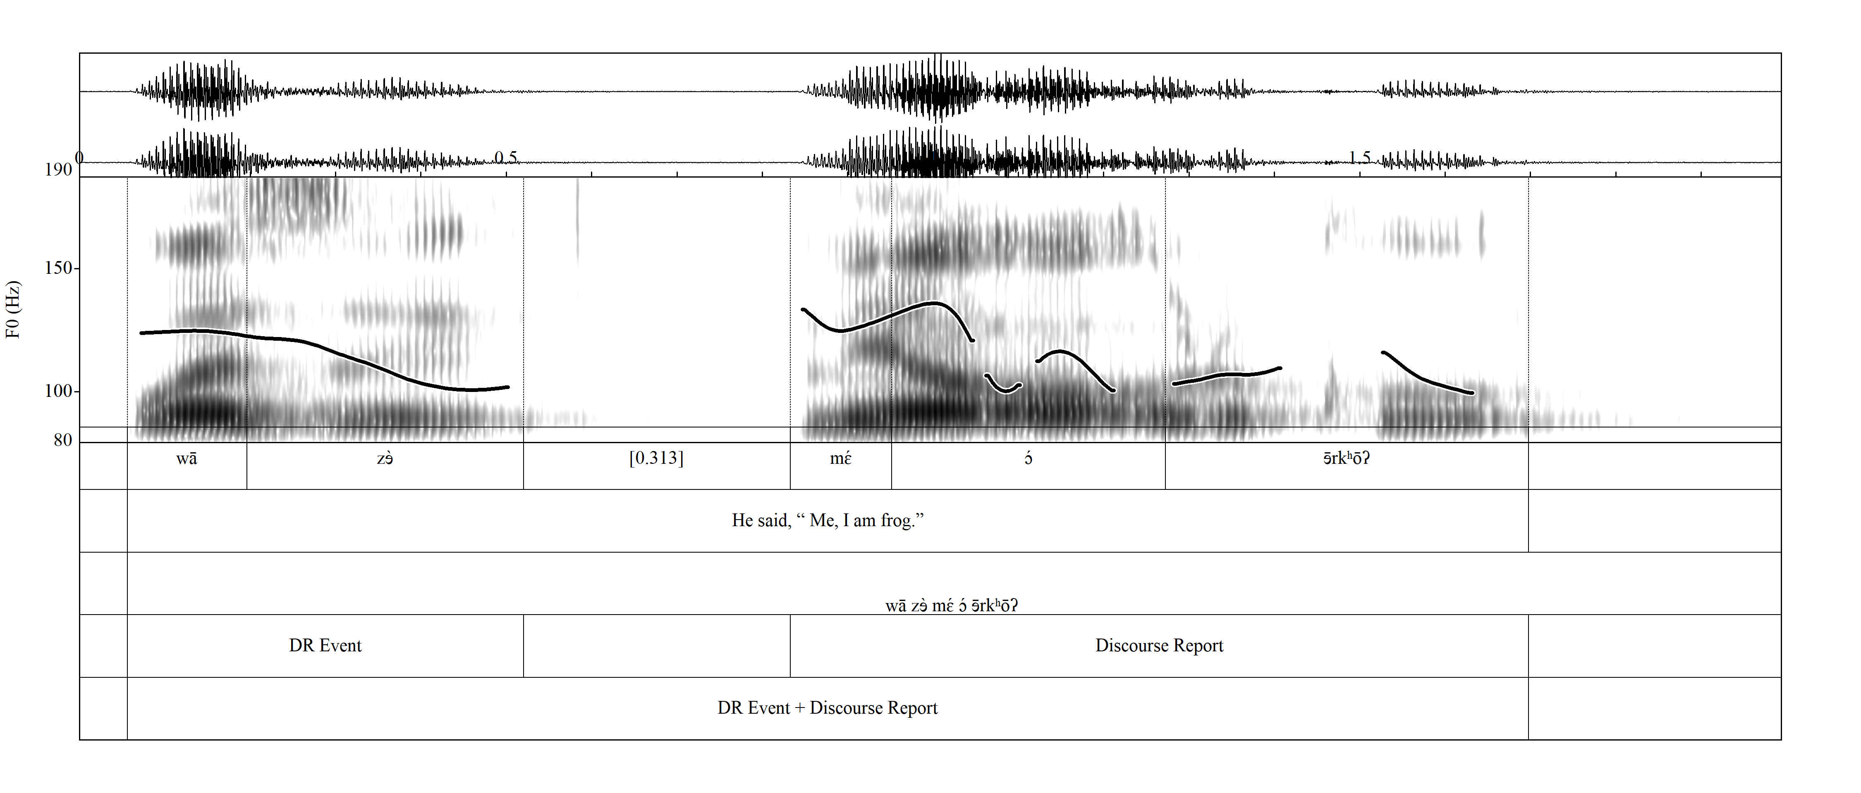
u̠t-Ma'in

Slide 33
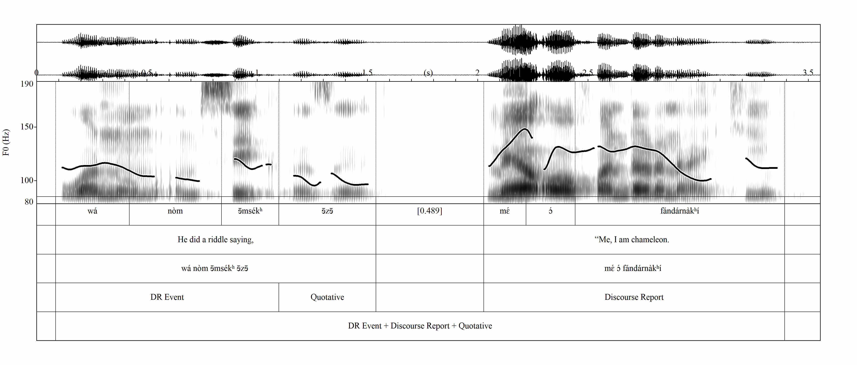
u̠t-Ma'in

Slide 34
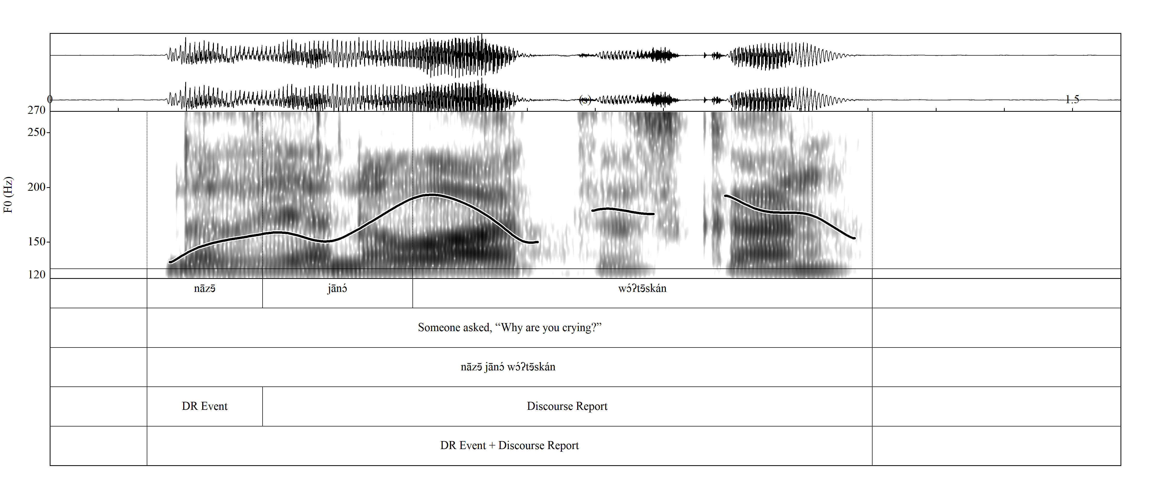
u̠t-Ma'in

Slide 35
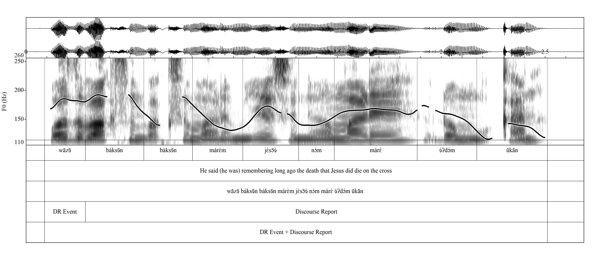
u̠t-Ma'in

Slide 36
Hirst, D. (2007). A Praat plugin for MOMEL and INTSINT with improved algorithms for modelling and coding intonation. ICPhS 2007. Proceedings of the 16th International Congress of Phonetic Sciences, 1233–1236.
Tonal
space
M
S
H
L
U
T
D
B

Slide 37
References
Couper-Kuhlen, E. (1997). Coherent Voicing: On Prosody in Conversational Reported Speech. In W. Bublitz, U. Lenk, & E. Ventola (Eds.), Coherence in Spoken and Written Discourse: How to Create it and How to Describe it. John Benjamins Publishing Company.
Genetti, C. (2014). Direct speech reports and the cline of prosodic integration in Dolakha Newar. Himalayan Linguistics, 10(1).
Malibert, I.-I., & Vanhove, M. (2015). Quotative constructions and prosody in some Afroasiatic languages. In Corpus-based Studies of lesser-described Languages: the CorpAfroAs Corpus of spoken AfroAsiatic (pp. 117–169). John Benjamins.
Wells, J. C. (2006). English intonation: An Introduction. Cambridge University Press.

